Slide 1


Optimize Hybird Application.
By Richard Jiang
The future is present -----Mobile Team

Slide 2


Some problems from Hybird solutions?
……..
Much More Data
To meet complex logics
Much More views
more native characteristic
Cache Management
Big file upload and download

Slide 3


Slide 4


Local Storage For Data
Don’t save big data in memory.
Apply offline database in application.
To do some filter action in database.
To do some offline mode.

Slide 5

Faster load H5 resources.
To integrate all JS, CSS file and compress.
To use webp format for images resources.
Better to use splash screen in hybird.
Load most of the resources when started.

Slide 6
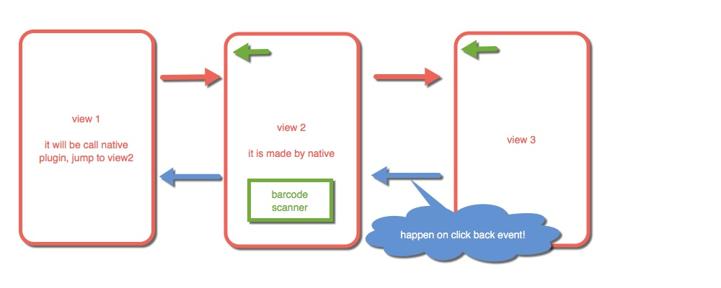
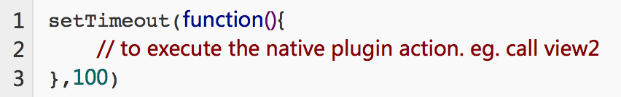
Faster load H5 resources.

Slide 7

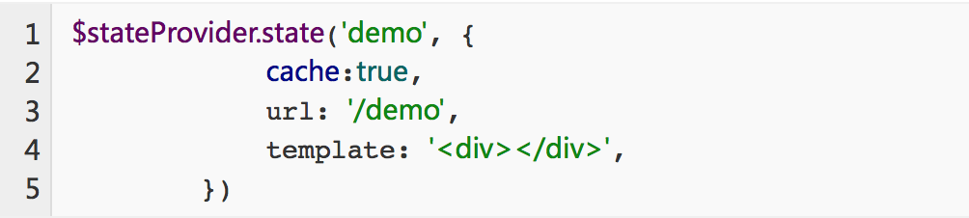
Transform Animation And Cache
Better to user Animation when the view start and initial.
Cache the view that do not need to update data.

Slide 8
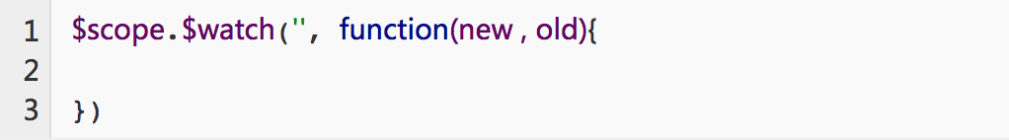
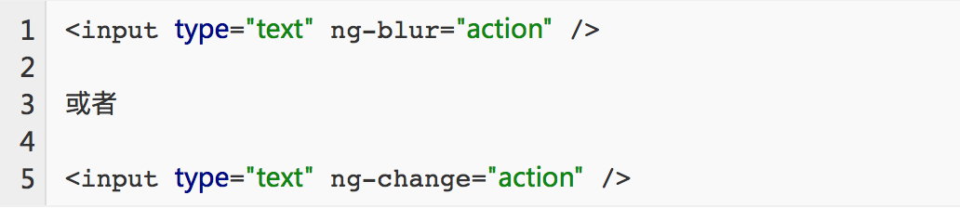
Do not use more monitor and watcher
Some monitor and watcher, as follow:
Solutions:

Slide 9
HTTP Request
Get data 1
Login View
Server
Get data 2
$q.all([async1,
async2,
async3...],
function(res2,
res2,
res3 ....){
})
……
Handle all responses
Main View

Slide 10
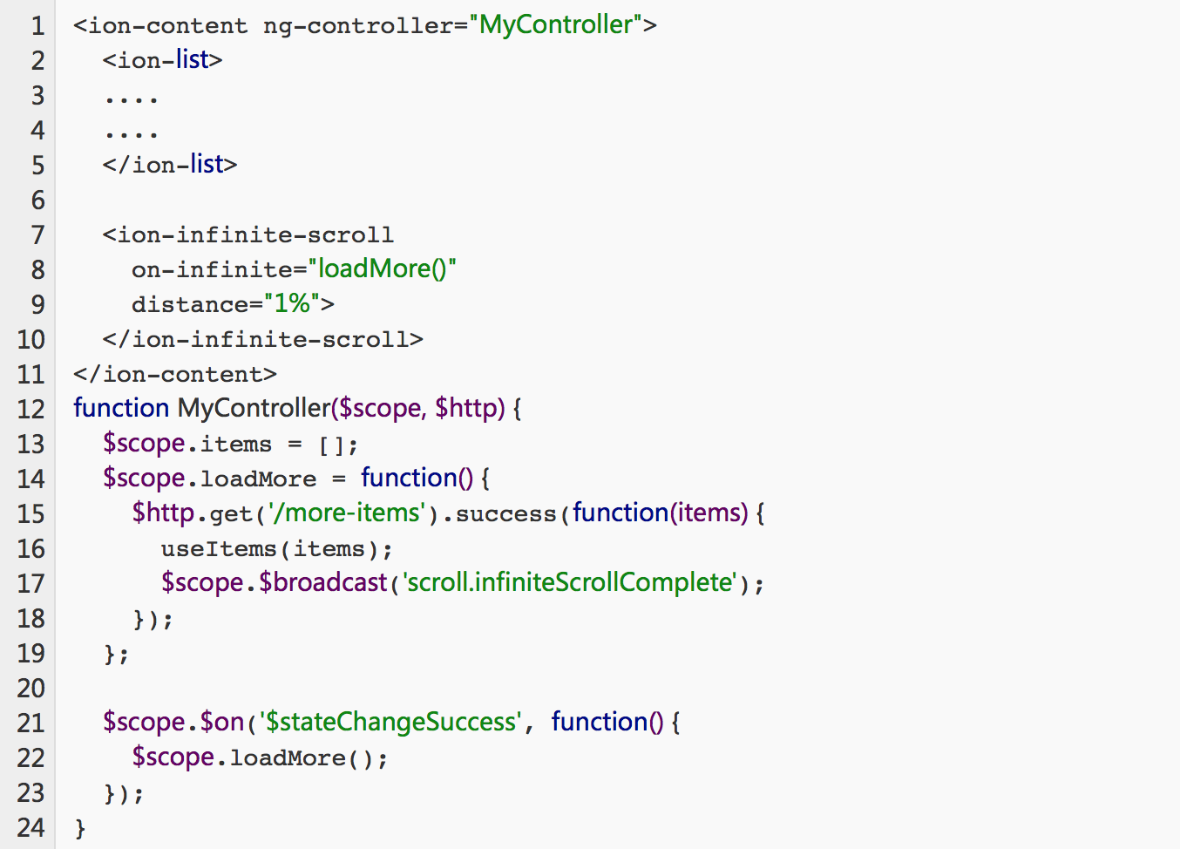
Handle big Data in list View
To handle the much more data by infinite scroll.

Slide 11
Use the right way to bind data.
Two way bind data. (Eg. Input , textbox…)
In order to reduce the memory
used.
One way bind data. (Eg. Validate the table list.)
One time bind data. (Eg. The detail of the news)

Slide 12
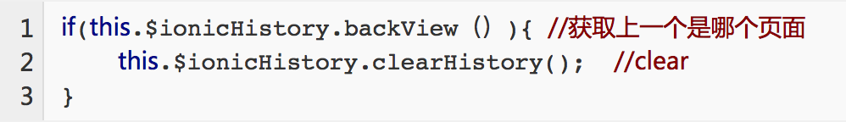
Clear Unused views
Eg. If the user was already login, won’t need login view, same with register workflow.

Slide 13
Clear Unused views
Eg. If the user was already login, won’t need login view, same with register workflow.

Slide 14
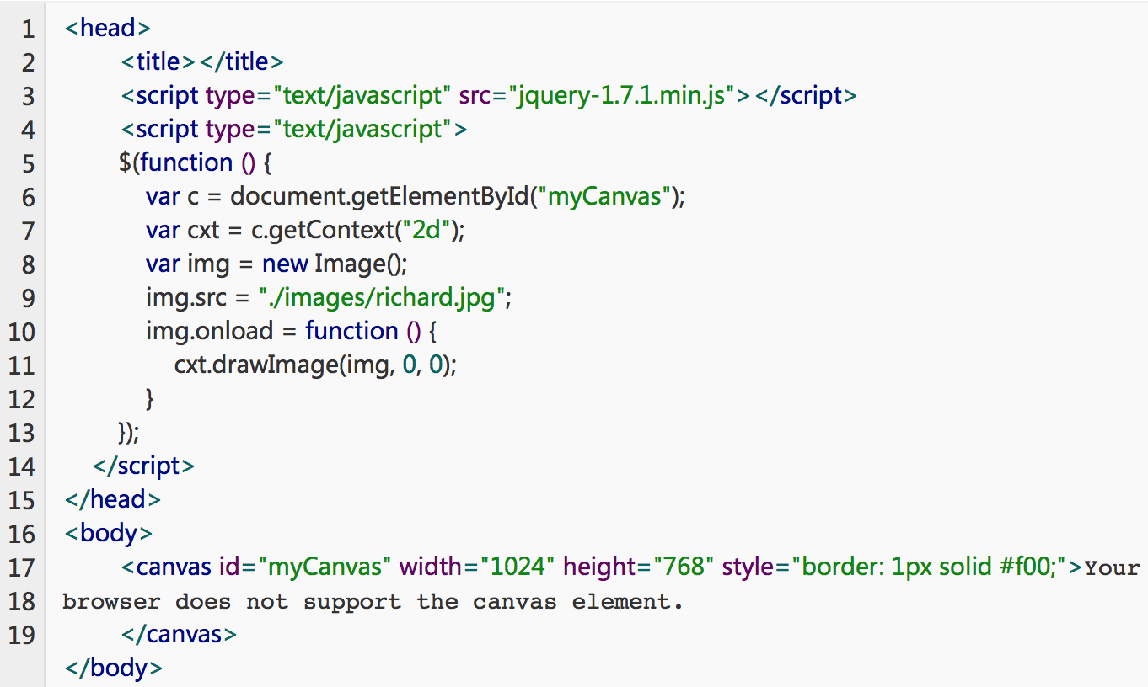
Load image by canvas

Slide 15
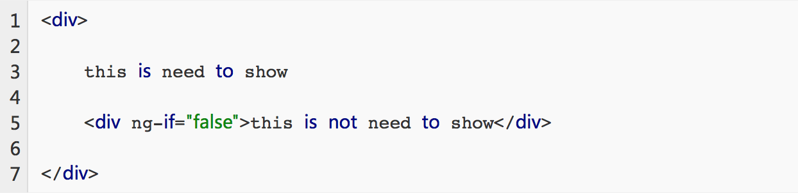
Do not canvas the unnecessary dom.
News Detail page
Note: As above code, if we use ng-show, it will be canvas
on Dom, even though it is not show.
About

Slide 16
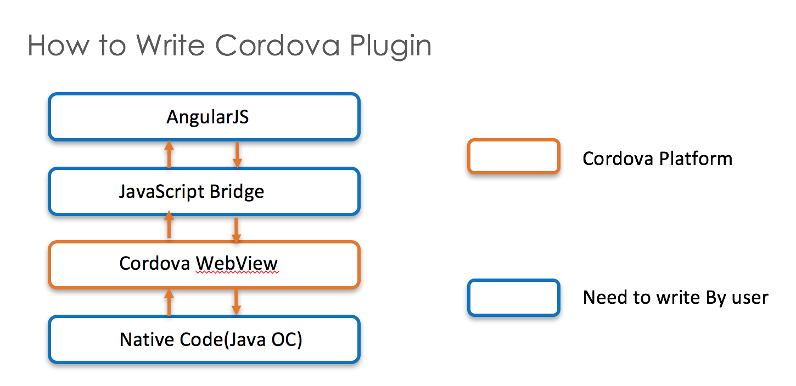
Don’t use setInterval call Native plugin.
Note: if you call same plugin very frequently, the action can not be released,
will be out of memory.

Slide 17

Font-end Code Engineered
Named the meaningful variable.
Apply the build tools in front-end.
Define the code rules(eg. jslint).
To write the annotation for some functions.
Notes:
有意义的变量命名，遵从驼峰命名法或者团队内部命名法则，统一规范。
使用JSLint对代码进行检查，所以人统一一个标准。
采用构建工具对工程进行自动化部署，减少操作步骤，比如使用npm command, gulp ,grunt webpack等等。
合理编写注释代码，方便阅读及他人接手，编译后切记要remove掉，因为对于产品环境，这些注释没有任何意义。
使用标准的代码仓库，比如git, bitbuket等等， 提交代码进行comment， 合理创建子分之，保证多人开发协作无冲突。
代码组件化或者模块化，争取做到一人一模块。一模块一个文件包或者一个文件，这样可以保证彼此没有冲突。
保证团队每个人对代码工程使用，烂熟于心，方便管理及升级。
任命技术负责人，负责代码统一管理，版本合并，产品发布。

Slide 18
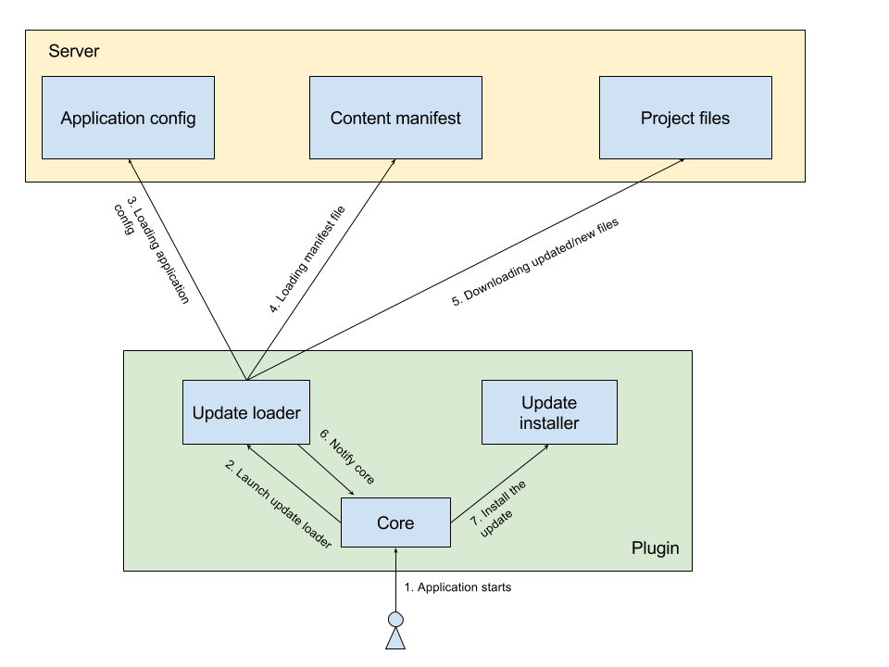
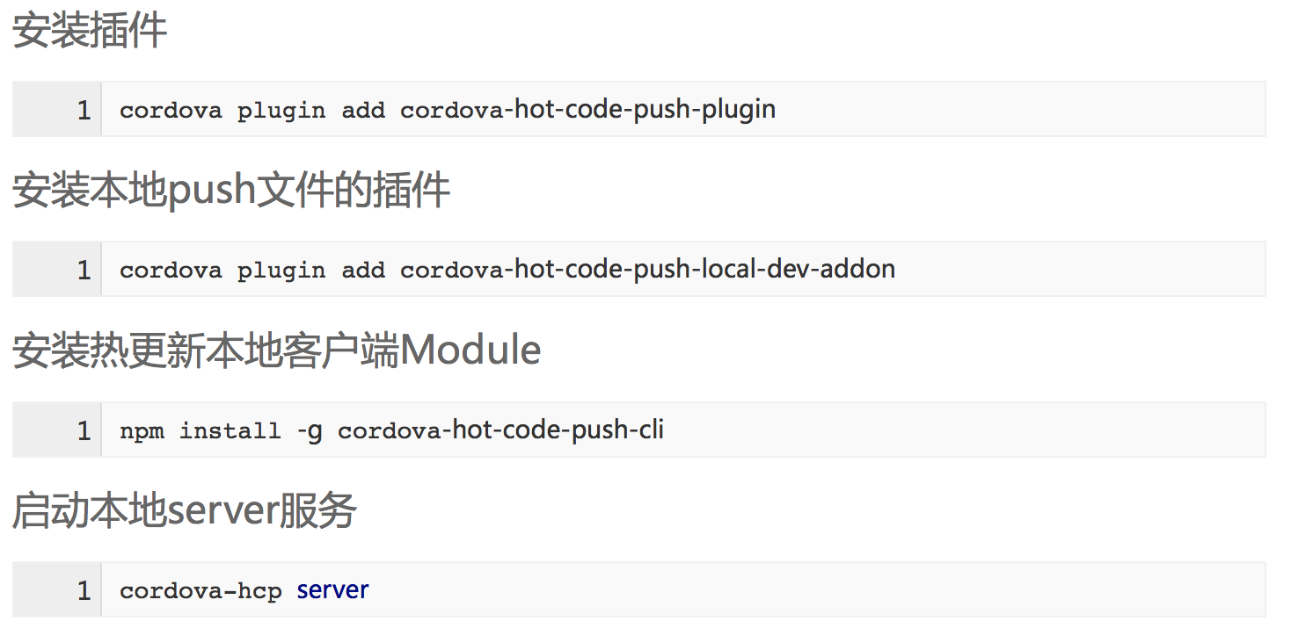
Hot Update For Testing And Production.
Hot Update Solutions as follow:
Notes:
有意义的变量命名，遵从驼峰命名法或者团队内部命名法则，统一规范。
使用JSLint对代码进行检查，所以人统一一个标准。
采用构建工具对工程进行自动化部署，减少操作步骤，比如使用npm command, gulp ,grunt webpack等等。
合理编写注释代码，方便阅读及他人接手，编译后切记要remove掉，因为对于产品环境，这些注释没有任何意义。
使用标准的代码仓库，比如git, bitbuket等等， 提交代码进行comment， 合理创建子分之，保证多人开发协作无冲突。
代码组件化或者模块化，争取做到一人一模块。一模块一个文件包或者一个文件，这样可以保证彼此没有冲突。
保证团队每个人对代码工程使用，烂熟于心，方便管理及升级。
任命技术负责人，负责代码统一管理，版本合并，产品发布。

Slide 19
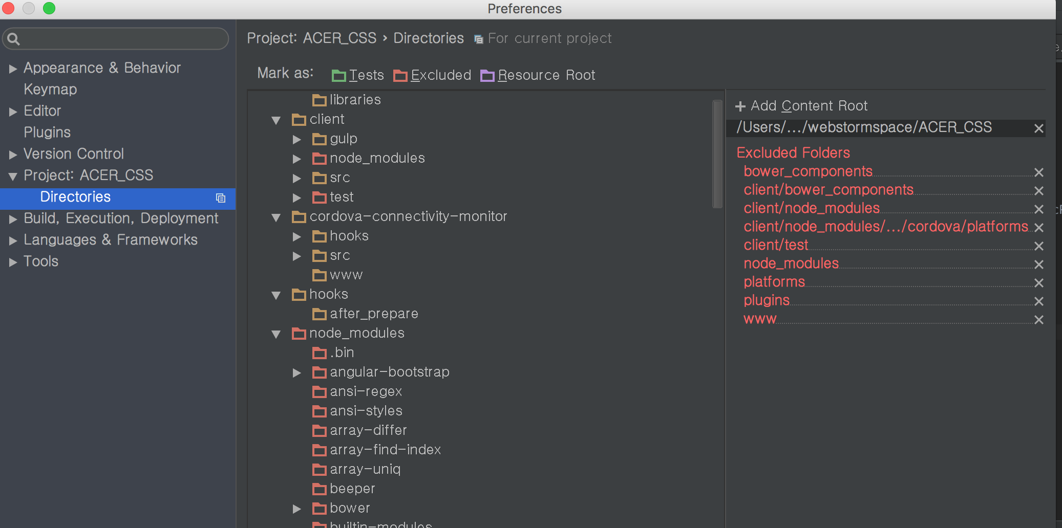


Optimize the development tools
Note: exclude the unnecessary folder and dependency library.

Slide 20


